Slide 1
Growing a Streaming Service Microsoft
Han & Jeff

Slide 2

Best Type of film
Measure Genre success on 3 scales
Earnings per film
Earnings per dollar invested in production
User engagement measured through number of user ratings from data source
Best Times for release
Measure film release cycles

Slide 3


Measures of success
$
Profitability
ROI
Growth and Synergy
Each project maximizing earnings
Maximizing earnings per dollar-spend on production
Maximizing user engagement
Promoting Microsoft’s other offerings
Take advantage of Microsoft’s other offerings

Slide 4

Data
Data Sources:
IMDB
Film Details (Genres etc.)
Film Ratings
The-Numbers.com
Film Budgets (Box Office, Production Cost)
The Movie Database
Film Ratings
Film Genres

Slide 5
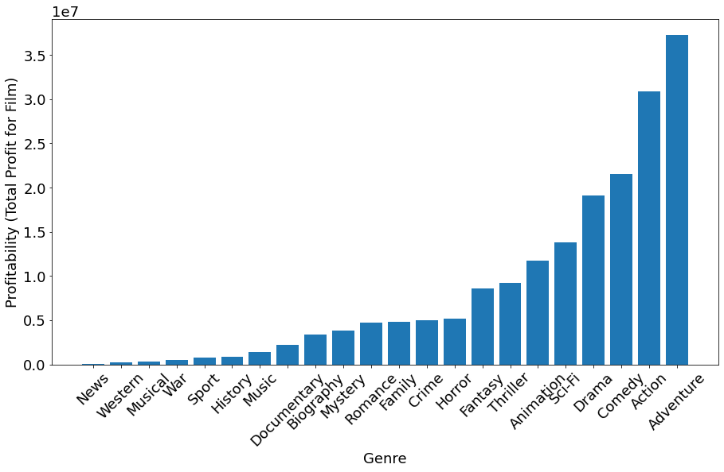
Average Profitability by Genre
Adventure
Action
Comedy
Drama
Sci-Fi
Animation
Data Sources:
IMDB
The-Numbers.com

Slide 6
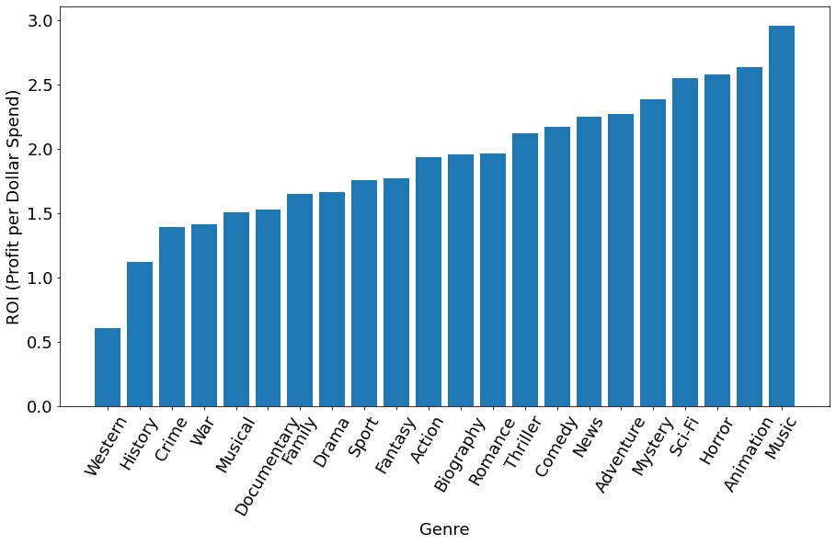
Average ROI by Genre
Adventure
Action
Comedy
Drama
Sci-Fi
Animation
Horror
Data Sources:
IMDB
The-Numbers.com

Slide 7
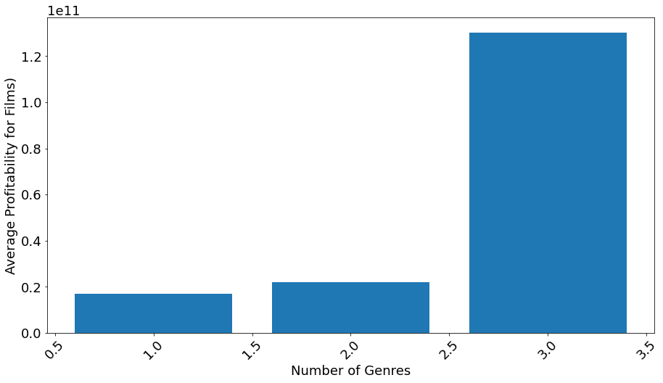
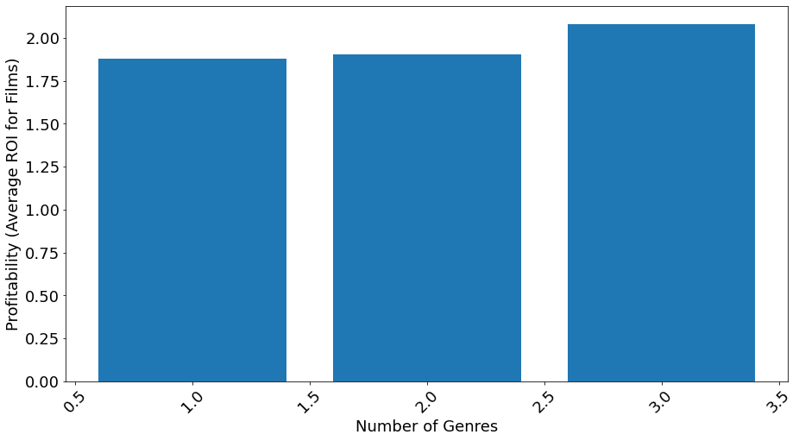
Returns by number of genres
Profitability by number of genres
ROI by number of genres

Slide 8
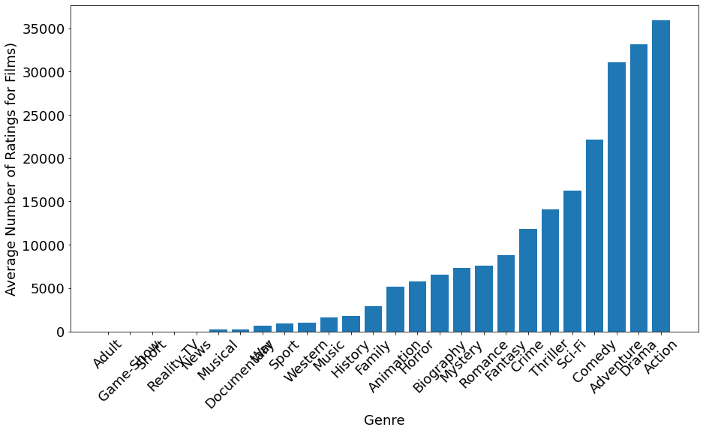
Average number of ratings by Genre
Adventure
Action
Comedy
Drama
Sci-Fi
Animation
Horror
Data Sources:
IMDB

Slide 9
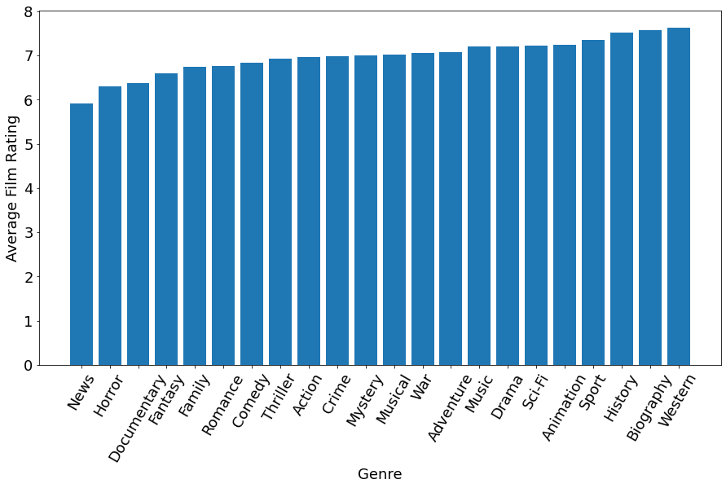
Average User Rating by Genre (IMDB)
Adventure
Sci-Fi
Animation
Action
Comedy
Drama
Biography
Data Sources:
IMDB

Slide 10
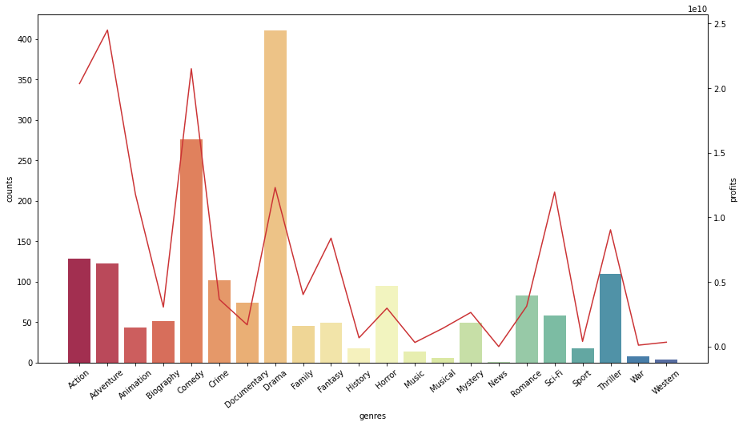
Market share by genre
Notes:
Money may not be the top priority, Reputation and user engagement maybe the key. 1 Market share How many movies in each genes in the market 2010-2019 -drama

Slide 11
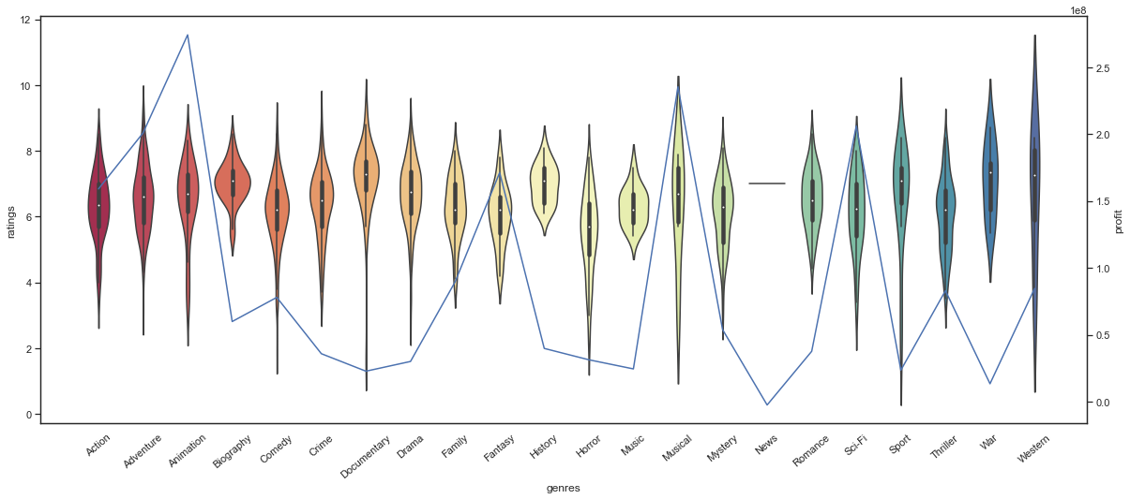
Distribution of ratings by genre
Notes:
2.1 reputation: ratings of genre -biography —Wall Street - wow, Diablo, lol -sci-fi -horror

Slide 12
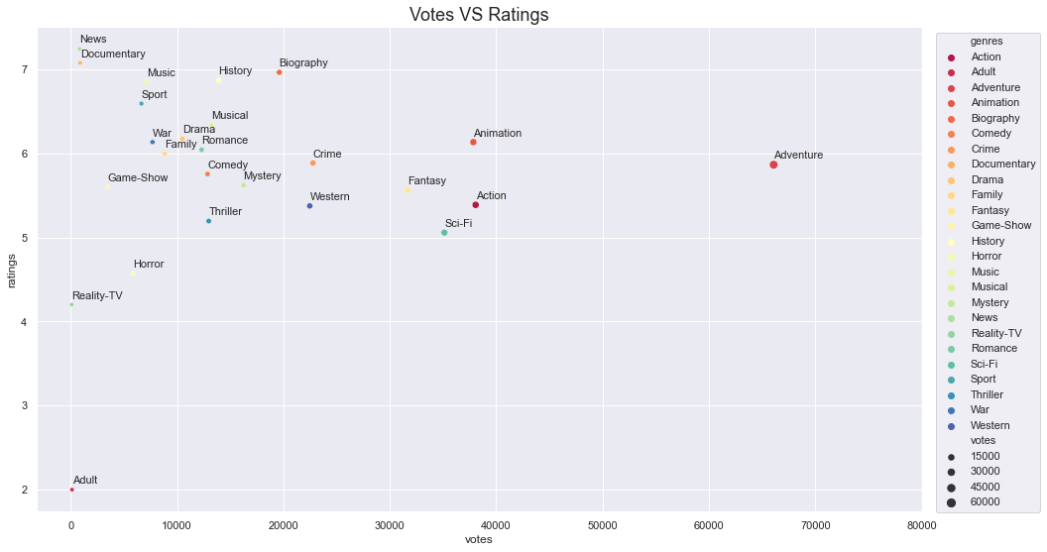
Correlation between ratings and votes
Notes:
2.2 Reputation: weighted Ratings vs votes Biography No perfect ones
Cross genre

Slide 13
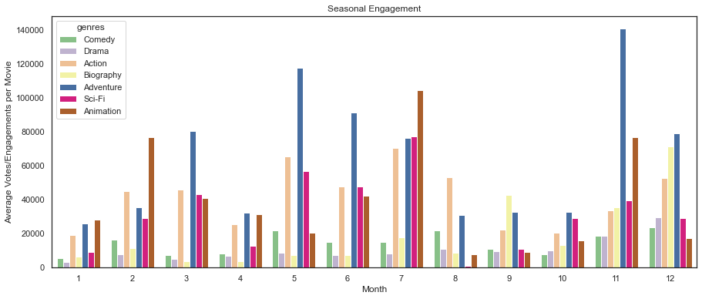
Viewer engagement of genres by month
Notes:
3 seasonal trend with our picked genres After narrow down, which season can get you best results. By season, engagement of selected genre -votes can be seen as user engagement -general, all year long, all movies doing better in peak season. , and small peak in Spring (Asian holidays) -outstanding: adventure, -sci-fi in summer -off peak season: biography in off peak season

Slide 14




Conclusion
Best Genres for profitability and engagement
Adventure
Sci-Fi
Animation
Action
Comedy
Drama
Biography
Release dates
Generally, release films during school breaks (Holidays and Early Summer)
Exception: late summer action/adventure films
Biography and Documentaries get late fall releases

Slide 15
THANK YOU
Mirjam Nilsson
mirjam@contoso.com
www.contoso.com

